Slide 1
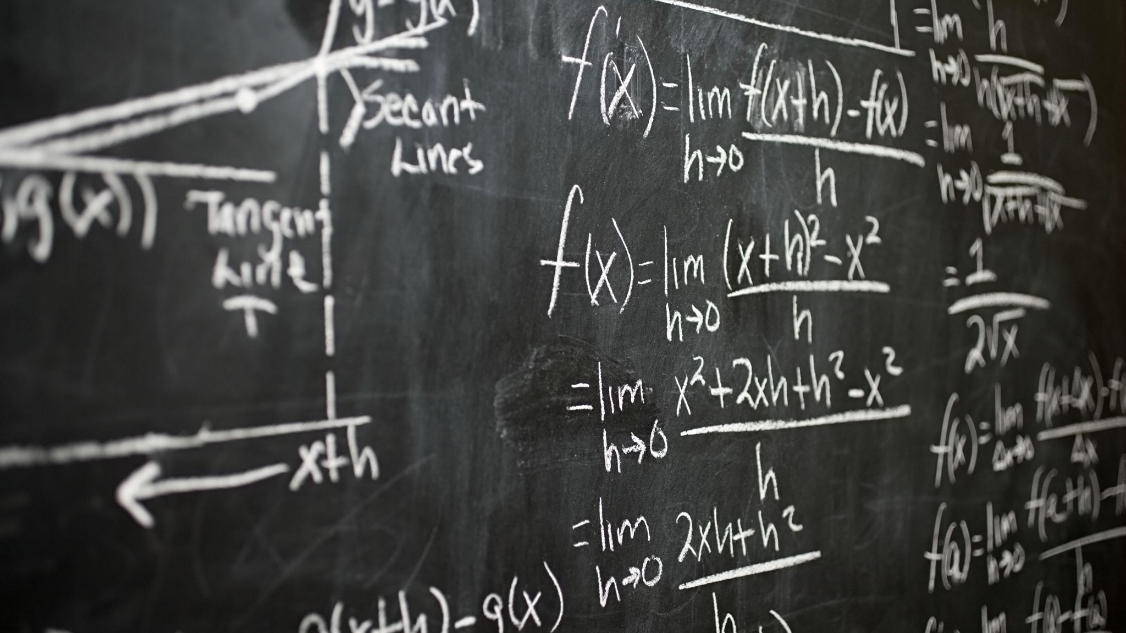



Slide 2

Presentation of E-learning website
Student ID | Member’s Name
0355610 | Dev Mani Maharjan
0355498 | Alina Khatri
0355468 | Romik Shrestha
0355545 | Rebica Shrestha
0355800 | Rosy Maharjan

Slide 3

ITS66404 Software Engineering

Slide 4
Introduction:
Our e-learning platform offers a user-friendly interface with various educational possibilities, including video lessons, online courses, and multimedia content. Users can easily find the courses they want and download free certifications. The platform also tracks users' progress and accomplishments, allowing them to focus on areas of improvement and recognize their strengths and weaknesses. Our goal is to provide accessible and valuable qualifications to all students, allowing them to learn new skills and information at their own pace and convenience.

Slide 5


Our website

Slide 6

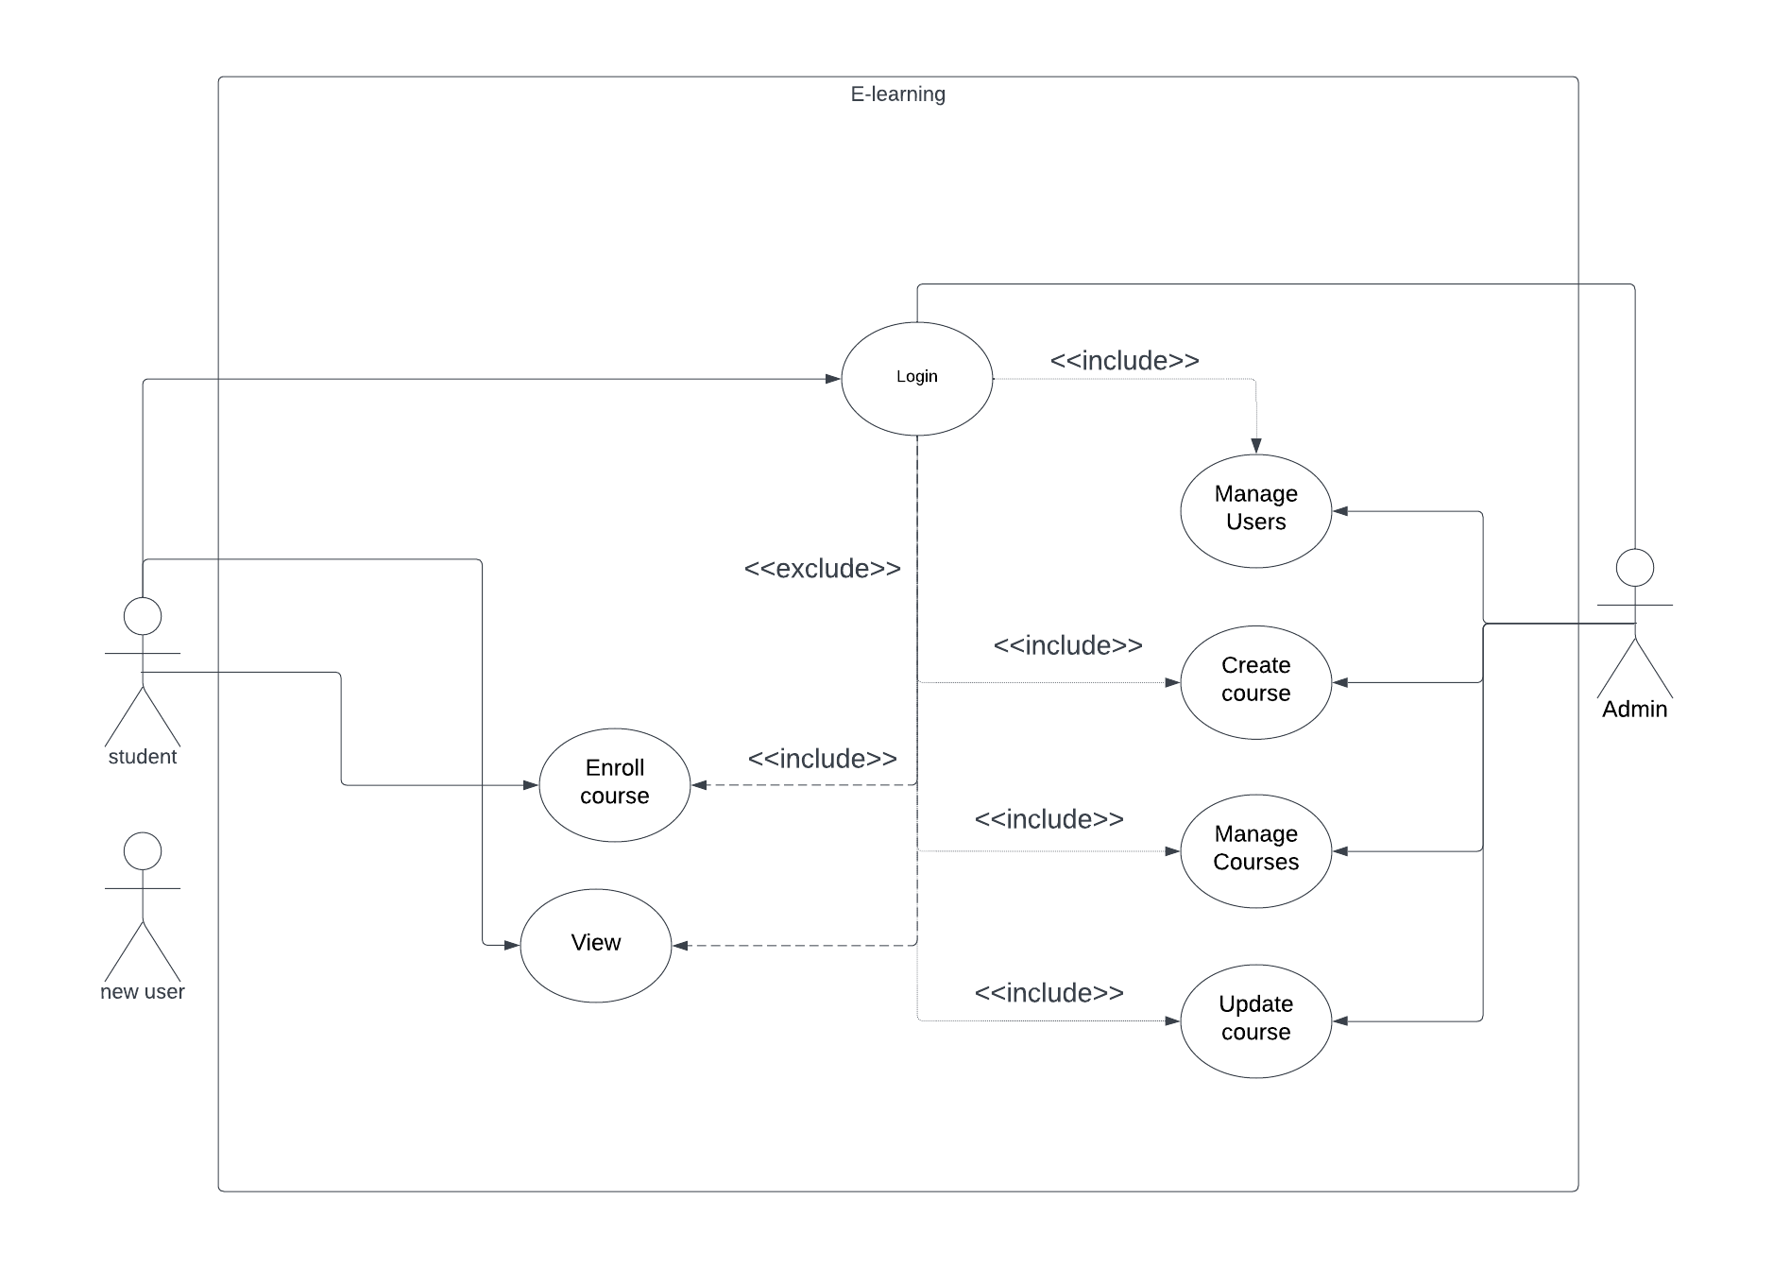
Use Case Diagram

Slide 7
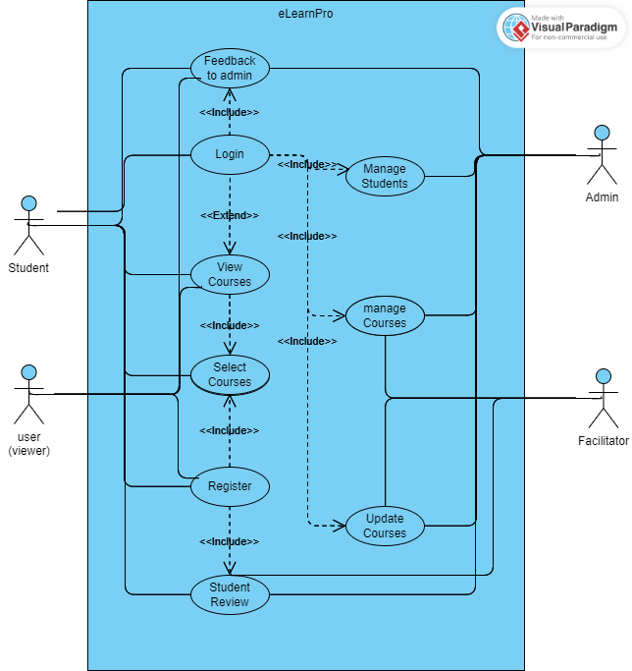
Modified Use Case Diagram

Slide 8

Use case diagram differences after mod
In the modified version of the use case diagram, several changes have been made compared to the old version
The new use case diagram includes additional actors and modifies the functionalities of existing actors
These changes in the use case diagram reflect the addition of a new actor and the modification of existing actor functionalities
The introduction of the Facilitator actor represents a new role that interacts with the system

Slide 9
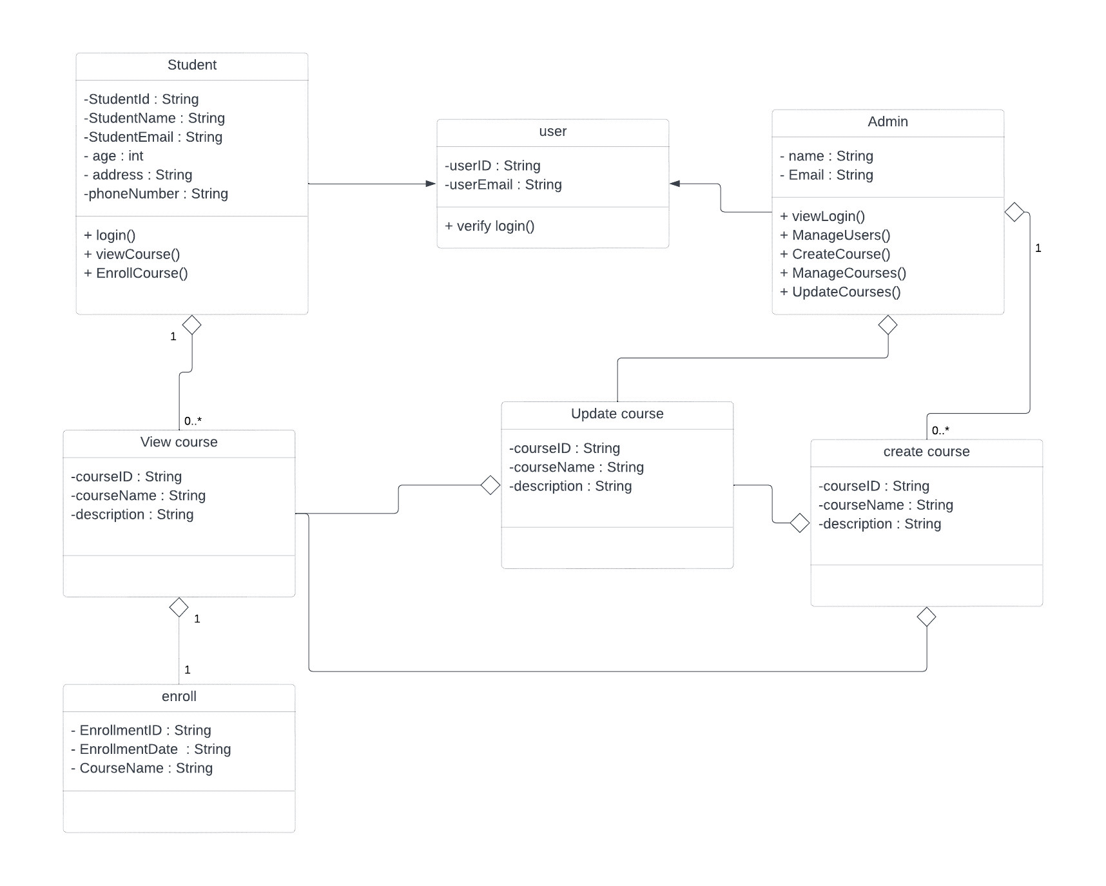
Class Diagram

Slide 10

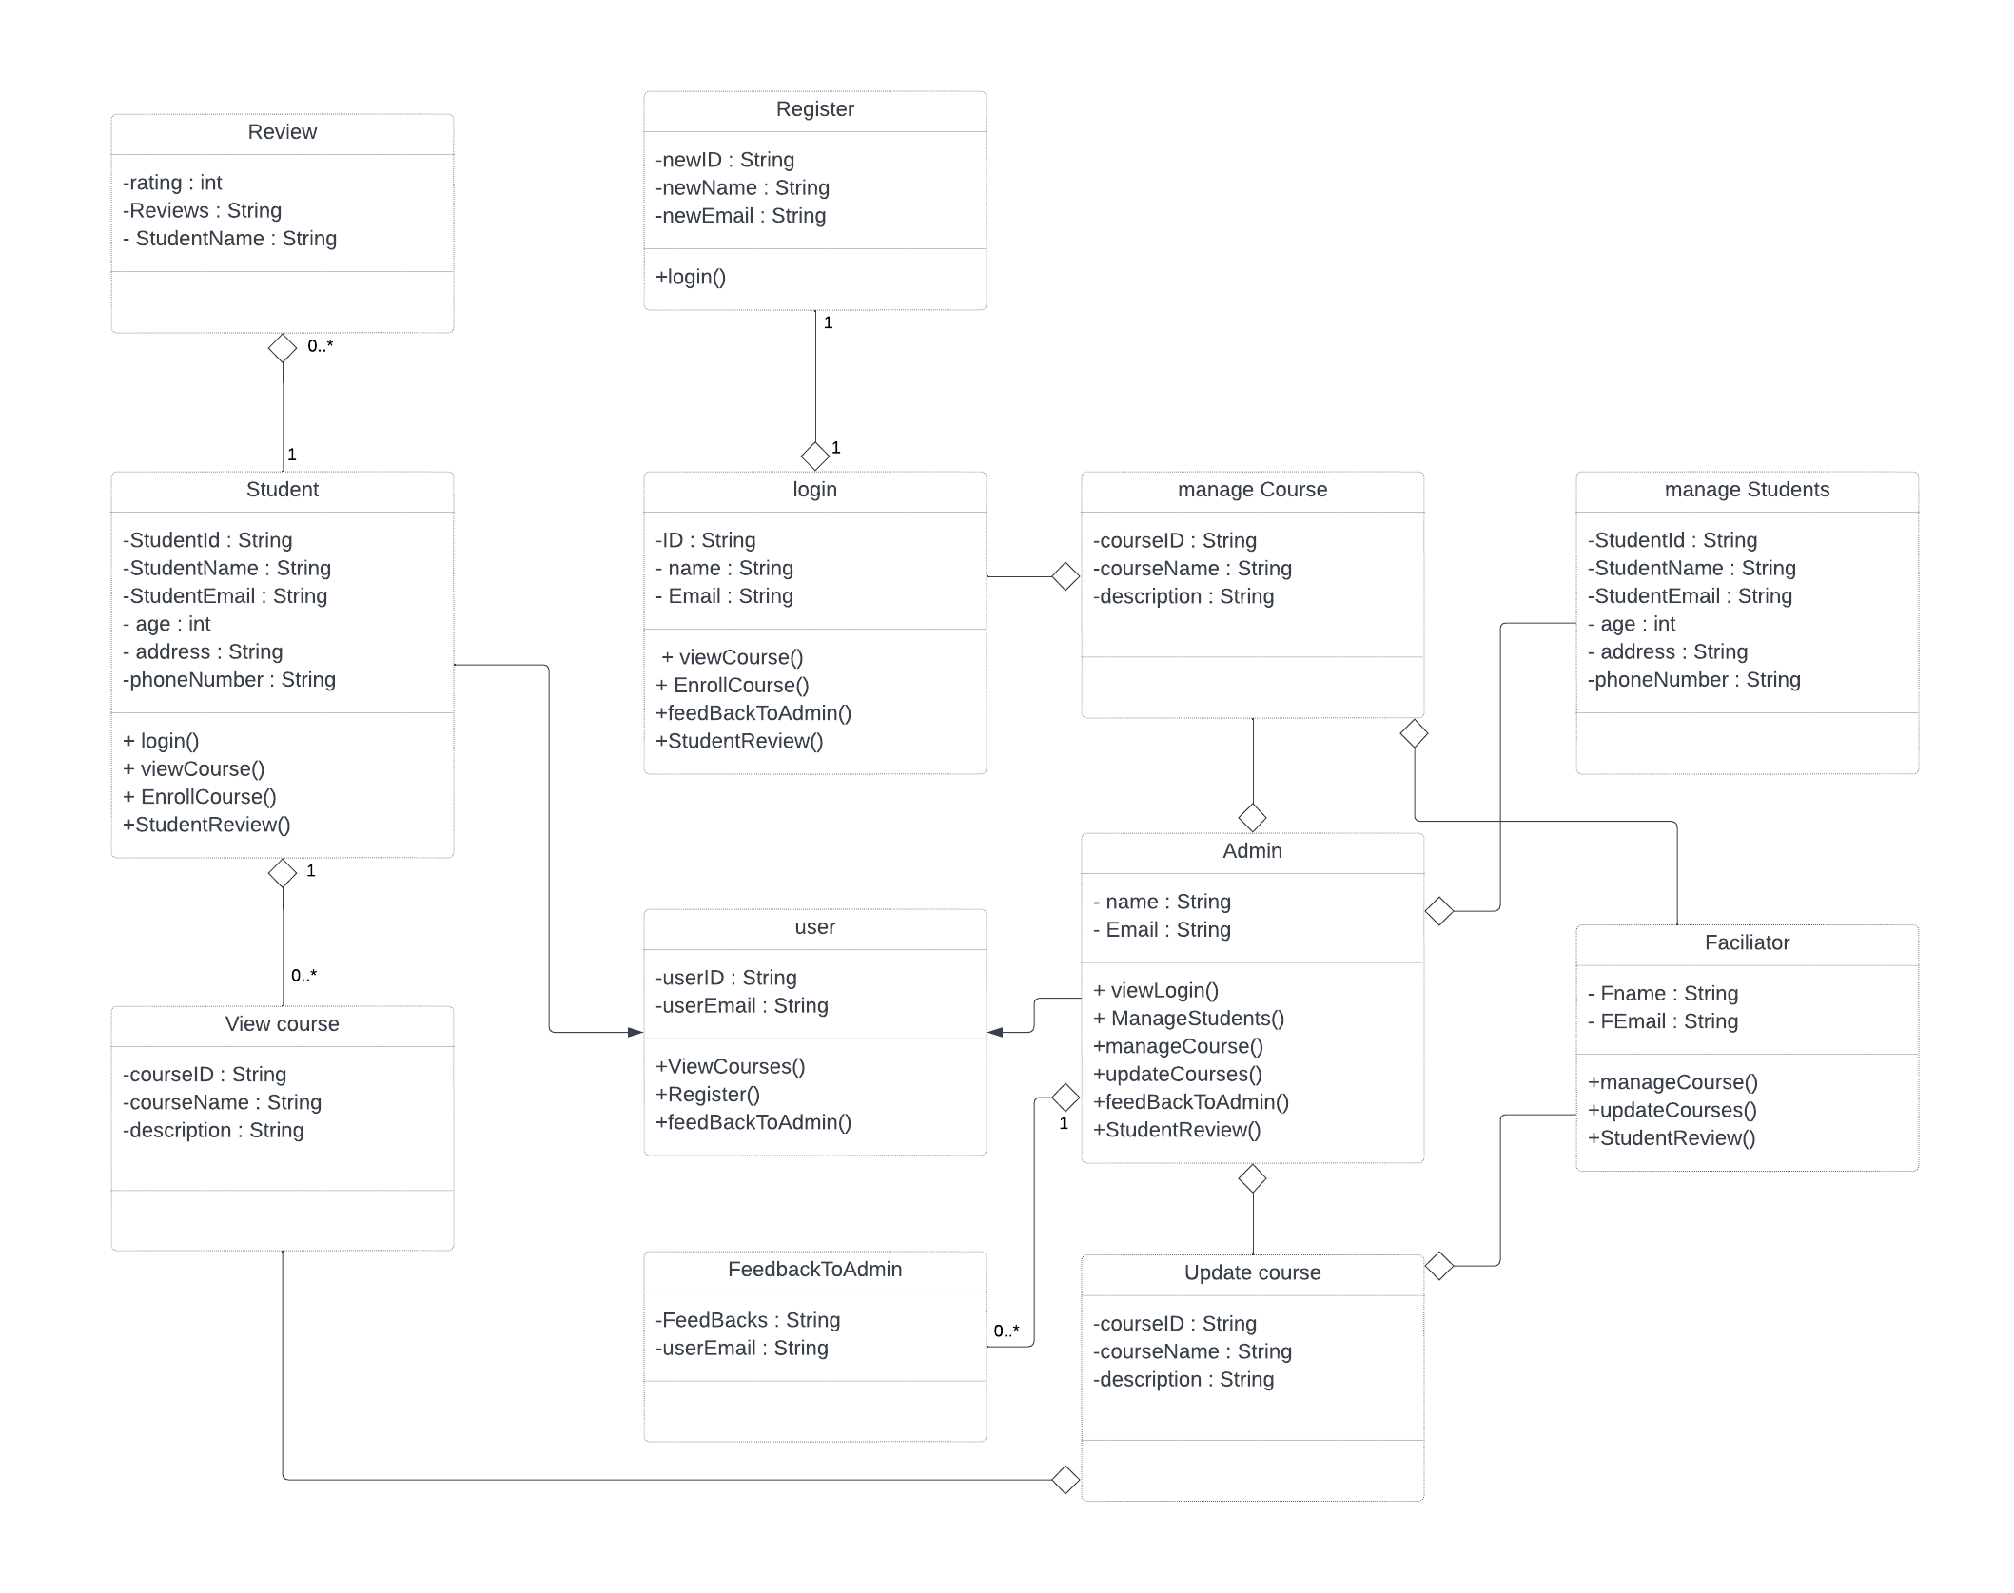
Modified class Diagram

Slide 11
Class diagram differences after mod
In comparing the old and new class diagrams, several modifications can be observed
The following is a detailed account of the changes made: Overall, the new class diagram demonstrates modifications and additions to the existing system's functionalities and entities
It reflects the inclusion of new features such as "review," "register," "facilitator," "login," "feedback to admin," "manage students," and "manage course," while removing "enroll" and "create course" from the previous design

Slide 12

Interface Design Proposal for E-learning Platform
Students, teachers, and educational institutions make up the main target market for the e-learning platform
The platform offers educational opportunities for students in K–12 through higher education
In-depth user research has been done to learn more about the wants and preferences of the target market
Key findings from surveys, interviews, and usability tests include the following: For students who like to learn while on the go, mobile compatibility is essential

Slide 13

Test Plan: E-Learning Platform Website
The website for the e-learning platform is a web-based platform that strives to give students a convenient and effective learning experience
The strategy, scope, objectives, and activities for testing the website for an e-learning platform are described in this test plan
The e-learning platform website will be tested using a combination of manual and automated testing approaches

Slide 14

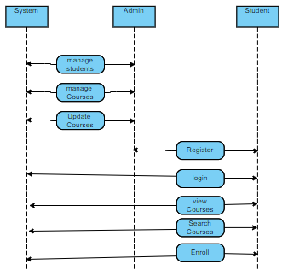
Sequence Diagram

Slide 15

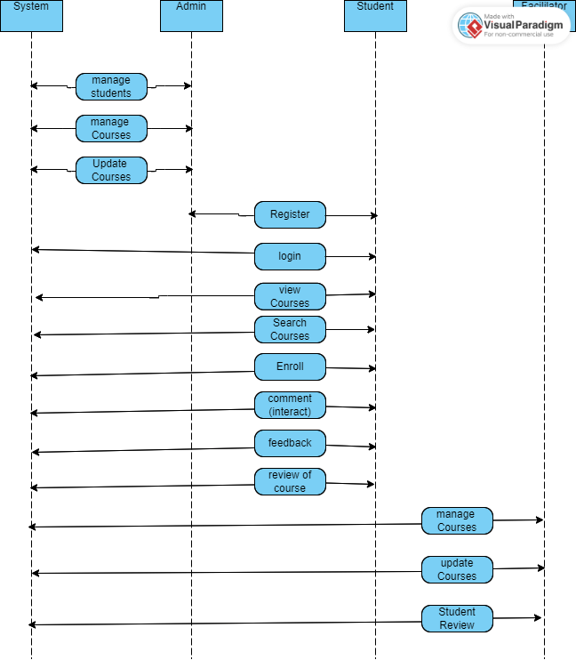
Modified Sequence Diagram

Slide 16

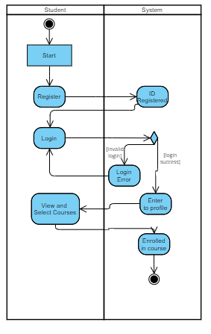
Activity Diagram

Slide 17
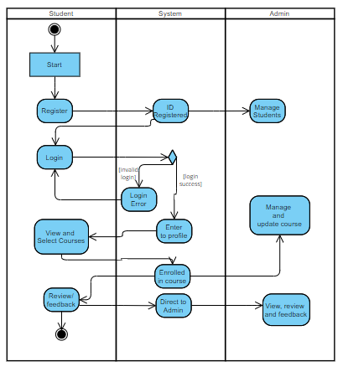
Modified Activity Diagram

Slide 18

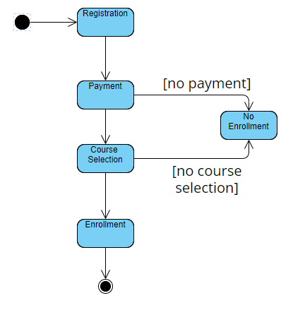
State Diagram

Slide 19
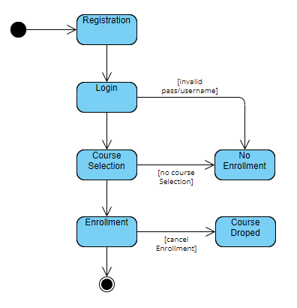
Modified State Diagram

Slide 20
Design Rationale
Strengths and Weaknesses of the Final Design: The final design of our eLearning website offers various advantages that center on offering a variety of courses and allowing user feedback
The large course catalog's breadth of subject matter and topics is one of its key advantages
To accommodate varied interests and learning requirements, we intended to develop a platform that offers a wide range of courses
We provide people the chance to study new fields of knowledge and improve their abilities across a range of disciplines by providing a large variety
Our design's user-friendly interface and simple navigation are other assets

Slide 21

Design Rationale
We placed a high priority on maintaining a smooth user experience, making it simple for consumers to explore and search for courses they are interested in
We placed a high priority on maintaining a smooth user experience, making it simple for consumers to explore and search for courses they are interested in

Slide 22

Alternative Design Ideas
We examined other concepts to further improve the functionality and user experience of our eLearning website as it was being designed
One of these suggestions was to include a feature for a virtual classroom that would allow for live video lectures, in-person conversations, and interactive sessions with lecturers
This online classroom would replicate a regular classroom setting and encourage face-to-face communication between teachers and students

Slide 23

Group Analysis
Our team, which was made up of five committed individuals, worked together to create our eLearning website
We were able to handle a wide variety of tasks and produce a high-quality output since each member contributed their special set of talents and knowledge
Our team was prepared to tackle the project's different facets thanks to our members' specializations in web development, design, content generation, and marketing
We were able to make the most of each team member's talents and develop a well-rounded eLearning website by establishing a collaborative environment and promoting open communication

Slide 24

Group Analysis
We will continue to improve our team relationships and produce outstanding results on future projects by adopting a more equitable task distribution and cultivating a culture of inclusion and cooperation

Slide 25
Summary:
The project focuses on the design and development of an e-learning platform website. The purpose of the website is to provide students, teachers, and educational institutions with a seamless and engaging learning experience. The project includes various components such as use case diagrams, class diagrams, interface design proposals, test plans, sequence diagrams, activity diagrams, and state diagrams.

Slide 26
Individual Participation
SN | Name | Responsibilities
1 | Dev Mani Maharjan | Systems Analysis & Design (Diagrams), Technologies and resources, Conclusion and Future Enhancement
2 | Alina Khatri | Problem, Solution and Innovation
3 | Romik Shrestha | System Requirements & Architectural Overview (Technical Architecture, UI, UX)
4 | Rebica Shrestha | Social impact of your project & business viability
5 | Rosy Maharjan | Introduction, Architectural Overview

Slide 27
THANK YOU FOR YOUR PRECIOUS TIME
\DO YOU HAVE ANY
QUESTIONS?

